Slide 1
REEU 2021: Geospatial analysis with python
Justin Gould (gould29@purdue.edu) Senior Data Scientist, The Data Mine
July 2021

Slide 2
Topics
Welcome
Introduction to course, instructor
Map Basics
What are Maps?
Geography vs. Geometry
Map Database Design
Visualizing Maps
Via Python and QGIS
PostGIS
Accessing postgres on Geddes
Transforming and Analyzing Spatial Data with Spatial SQL
Justin Gould | gould29 | REEU 2021

Slide 3
Introduction

Slide 4
Module Schedule
Monday:
Introduction
Install/set up Python, QGIS
Map Basics
Tuesday:
Map Database Design Principles
Wednesday:
Map Design Principles
Visualizing Maps
Thursday:
Basic PostGIS
Friday:
Advanced PostGIS
Justin Gould | gould29 | REEU 2021

Slide 5

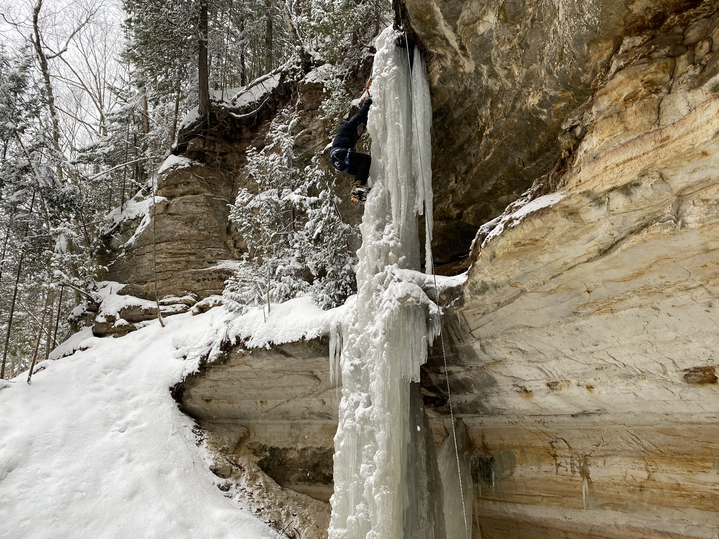
Who am I?
Current Role: Senior Data Scientist in the Data Mine
Technical advisor to students working on corporate projects
Data Science consultant with faculty/staff for large companies
Hobbies:
Rock and ice climbing
Classical music
Reading (https://gouldju1.github.io/gouldju1/pages/reading-list.html)
Justin Gould | gould29 | REEU 2021

Slide 6


Who am I?
DTE Energy
Route optimization and coordinate system conversion API
Web-based SQL query generation app (asset management)
Stryker Orthopaedics
Correlate procedures which use Stryker products to demographics, and predict demographic growth in US regions for sales/lead generation
Justin Gould | gould29 | REEU 2021

Slide 7


Who am I?
Product Sustainability Analytics
On-road vehicle data to quantify fuel and emissions savings of engine start/stop feature
Connected Vehicles/Driver Assist Technology (DAT)
Hands-free feature in Mach-E!
Route prediction (from key on/key off events)
DAT feature map generation and analysis tool
ETL pipeline for on-road vehicle data, build feature availability map, virtually “drive” map via predicted routes, and quantify where feature performance can be improved
Product Owner of CV data discovery tool
Justin Gould | gould29 | REEU 2021

Slide 8
Who am I?
Natural Language Processing
Question & Answering
NL2SQL (Natural Language to SQL)
Input table and natural language question; translate into executable SQL query
Product Owner of NLP products and model API catalog
Machine translation, Q&A, document classification
All NLP work reusable via microservice architecture and published in API catalog for widespread adoption
Business engagement
How can we convince Ford colleagues to “purchase” NLP models and applications
Justin Gould | gould29 | REEU 2021

Slide 9
Setting up Python
We will create the conda environment for our course and run through a couple exercises!
Course virtual environment
Open your terminal (Mac) or the Anaconda command prompt (Windows)
Run: conda create --name reeu2021 pip
This will create a virtual environment called reeu2021 with the pip package
Download requirements.txt from the email from Justin Gould
Run: conda activate reeu2021
cd to where requirements.txt is located and run: pip install –r requirements.txt
Justin Gould | gould29 | REEU 2021

Slide 10
Installing QGIS
QGIS is, in short, an open-source version of Esri ArcGIS, which you have used in this course
To install, navigate to the following:
https://qgis.org/en/site/forusers/download.html
Justin Gould | gould29 | REEU 2021

Slide 11
Map Basics

Slide 12
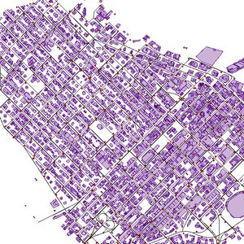
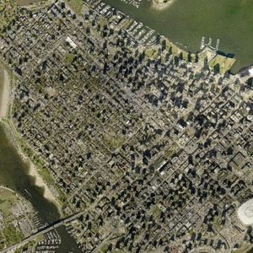
What are Maps?
Geospatial data are the collective data and associated technology containing geographic or locational components
Coordinates, address, city, satellite imagery, etc.
Vector vs. Raster
Vector
Graphical representations of the real world: points, lines, and polygons
Connecting points create lines, and connecting lines that create an enclosed area are polygons
Raster
Data that is presented in a grid of pixels…typically refers to imagery (Google Maps)
Each “segment” on a map can store values: color, unit of measurement, etc.
Justin Gould | gould29 | REEU 2021

Slide 13
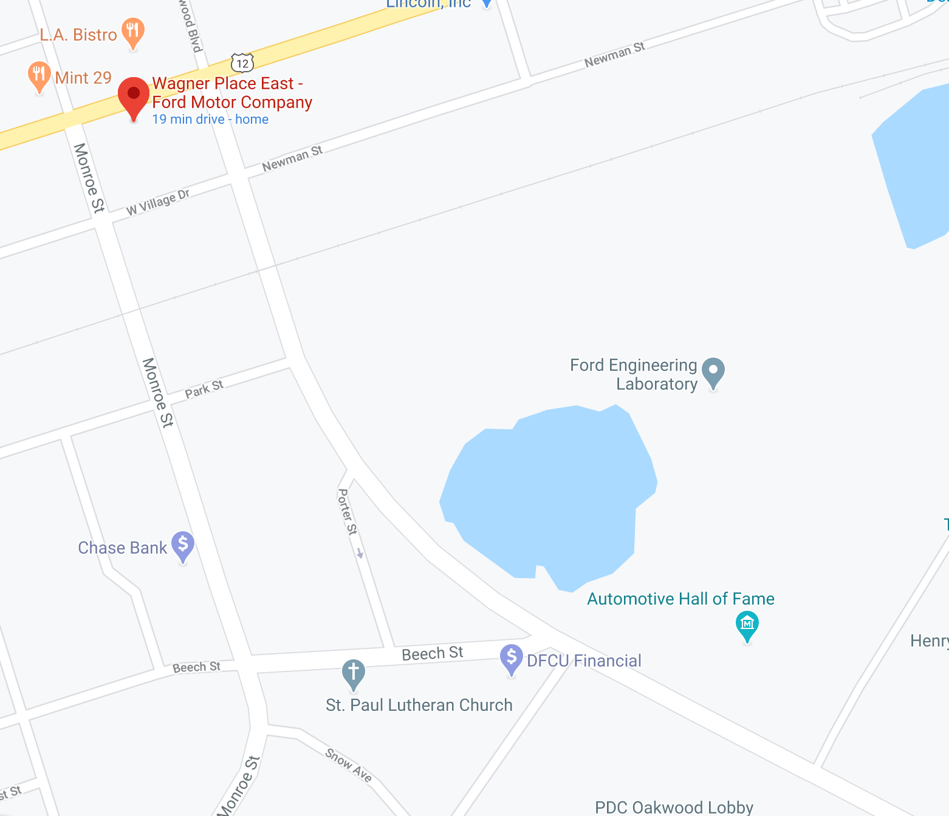
What are Maps?
Think of a map as a graph, with nodes and edges (edges connecting nodes)
A straight line drawn between nodes = edge
More data (ideally at each change in road curvature, get a new point) = cleaner map
Justin Gould | gould29 | REEU 2021

Slide 14
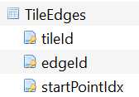
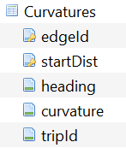
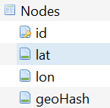
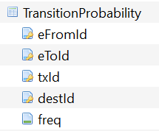
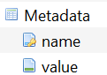
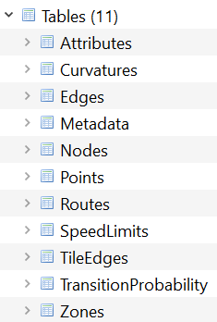
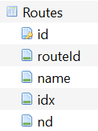
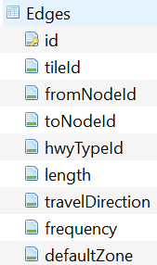
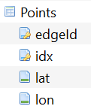
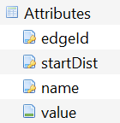
What are Maps?
Maps can also be a database
Justin Gould | gould29 | REEU 2021

Slide 15
What are Maps?
Visualizing map database and attributes associated with vector data (lines and points) – think back to the idea of a graph
Segment ID
Segment length
Min lane width
Max lane width
Left avg LMC
Right avg LMC
ADAS availability
Has pothole
Construction
…
…
…
Justin Gould | gould29 | REEU 2021

Slide 16
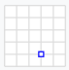
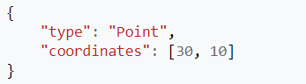
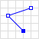
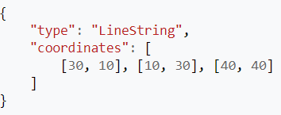
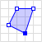
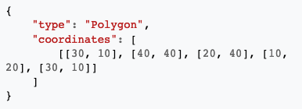
Geometry (Spatial Data) Types
How can we codify spatial data and represent vector geometry in code?
Geometric objects: 2D (x, y), 3D (x, y, z (i.e., altitude))
Type | Definition | Shapes | Examples
Point
A given space (lon lat)
POINT(-83.2456381 42.3061845)
Connected series of points
LINESTRING(POINT, POINT, POINT, …)
Linestring
Closed shape defined by a connected sequence of (lon lat) pairs
Polygon
POLYGON((POINT, POINT, …))
Justin Gould | gould29 | REEU 2021

Slide 17
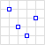
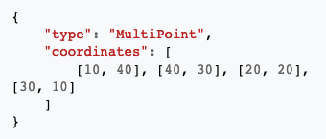
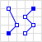
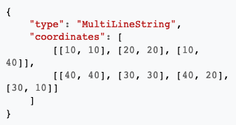
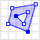
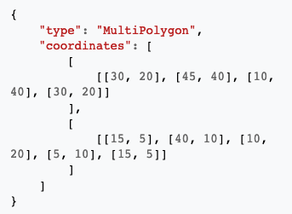
Geometry (Spatial Data) Types
How can we codify spatial data and represent vector geometry in code?
Geometric objects: 2D (x, y), 3D (x, y, z (i.e., altitude))
Type | Definition | Shapes | Examples
Multipoint
Ordered collection of points
MULTIPOINT(POINT, POINT, POINT, …)
A collection of > 1 linestrings
Multilinestring
MULTILINESTRING(LS, LS, LS, …)
A collection of polygons that consists which construct from exterior ring and hole list tuples
Multipolygon
MULTIPOLYGON(POLYGON, POLYGON, POLYGON, …)
Justin Gould | gould29 | REEU 2021
Notes:
One example where I've seen multilinestrings in routing networks is where they allow the string to be segmented based on speed limit, like a road network

Slide 18
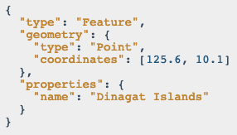
Geometry (Spatial Data) Types
As we’ve seen, spatial data are typically represented as strings or numeric values:
Well-known text (WKT) is a text markup language for representing vector geometry objects:
“POINT(LON LAT)”
“LINESTRING(POINT, POINT, …)”
GeoJSON is a format for encoding a variety of geographic data structures:
Justin Gould | gould29 | REEU 2021

Slide 19
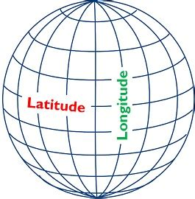
Coordinates and Coordinate Systems
Coordinate systems contained within EPSG Registry
Standard = WGS84 (World Geodetic System 1984)
Latitude/longitude coordinate system based on the Earth's center of mass
For example, raw GPS data from vehicles comes in this coordinate system
Web Mercator Projection (EPSG:3857) = used for display by web-based maps
Variant of WGS84, but can be represented in meters
~6,000 coordinate systems registered through EPSG Registry
States, countries can have their own coordinate system
A coordinate system is a projection of spatial data on a flat surface
Since there is no perfect way to transpose a curved surface to a flat surface without some distortion, many different map projections exist that provide different properties.
Justin Gould | gould29 | REEU 2021
Notes:
Some map projections (coordinate systems) preserve shape, while some preserve distance. Others preserve area or direction.

Slide 20
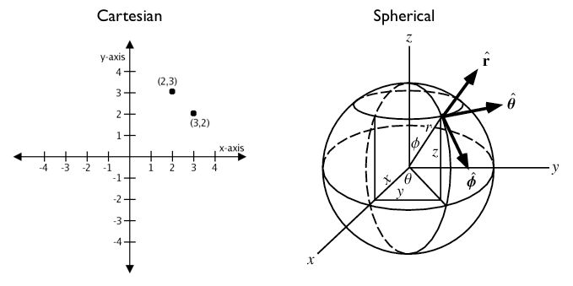
Geography: Cartesian vs. Spherical
Justin Gould | gould29 | REEU 2021
Notes:
Unlike coordinates in Mercator, UTM, or Stateplane, geographic coordinates are not Cartesian coordinates. Geographic coordinates do not represent a linear distance from an origin as plotted on a plane. Rather, these spherical coordinates describe angular coordinates on a globe. In spherical coordinates a point is specified by the angle of rotation from a reference meridian (longitude), and the angle from the equator (latitude).

Slide 21
Geography: Cartesian vs. Spherical
Calculating Cartesian distance
Cartesian points are on a plane with 2 dimensions: x (latitude) and y (longitude)
You can calculate the shortest path (in degrees, in our case), as you would any two points on a plane
Justin Gould | gould29 | REEU 2021

Slide 22
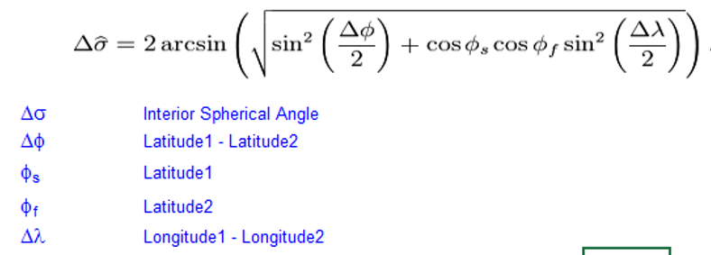
Geography: Cartesian vs. Spherical
Calculating Spherical distance
Since our earth is round, calculating distance between 2 points is more challenging
Haversine formula:
Justin Gould | gould29 | REEU 2021
Notes:
The haversine formula is a very accurate way of computing distances between two points on the surface of a sphere using the latitude and longitude of the two points. The haversine formula is a re-formulation of the spherical law of cosines, but the formulation in terms of haversines is more useful for small angles and distances.

Slide 23
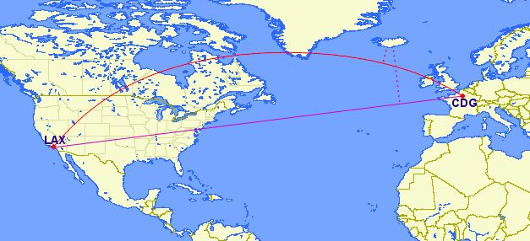
Geography: Cartesian vs. Spherical
Calculate the distance between Los Angeles, California and Paris, France…
Justin Gould | gould29 | REEU 2021
Notes:
You can treat geographic coordinates as approximate Cartesian coordinates and continue to do spatial calculations. However, measurements of distance, length and area will be nonsensical. Since spherical coordinates measure angular distance, the units are in “degrees.” Further, the approximate results from indexes and true/false tests like intersects and contains can become terribly wrong. The distance between points get larger as problem areas like the poles or the international dateline are approached.
Working with geographic coordinates on a Cartesian plane (the purple line) yields a very wrong answer indeed! Using great circle routes (the red lines) gives the right answer.

Slide 24
Geography: Cartesian vs. Spherical
Calculate the distance between Los Angeles, California and Paris, France…
SELECT
ST_Distance(
ST_GeometryFromText('POINT(-118.4107 33.9415)', 4326),
ST_GeometryFromText('POINT(2.5457 49.0096)', 4326)
);
>> 121.891338 (degrees)
Distance between points Create cartesian point Coordinate system code for Cartesian
Justin Gould | gould29 | REEU 2021
Notes:
You can treat geographic coordinates as approximate Cartesian coordinates and continue to do spatial calculations. However, measurements of distance, length and area will be nonsensical. Since spherical coordinates measure angular distance, the units are in “degrees.” Further, the approximate results from indexes and true/false tests like intersects and contains can become terribly wrong. The distance between points get larger as problem areas like the poles or the international dateline are approached.
Aha! 121! But, what does that mean?
The units for spatial reference 4326 are degrees. So our answer is 121 degrees. But (again), what does that mean?
On a sphere, the size of one “degree square” is quite variable, becoming smaller as you move away from the equator. Think of the meridians (vertical lines) on the globe getting closer to each other as you go towards the poles. So, a distance of 121 degrees doesn’t mean anything. It is a nonsense number.
In order to calculate a meaningful distance, we must treat geographic coordinates not as approximate Cartesian coordinates but rather as true spherical coordinates. We must measure the distances between points as true paths over a sphere – a portion of a great circle.

Slide 25
Geography: Cartesian vs. Spherical
Calculate the distance between Los Angeles, California and Paris, France…
SELECT
ST_Distance(
ST_GeometryFromText('POINT(-118.4107 33.9415)', 4326),
ST_GeometryFromText('POINT(2.5457 49.0096)', 4326)
);
>> 121.891338 (degrees)
SELECT
ST_Distance(
ST_GeographyFromText('POINT(-118.4107 33.9415)'),
ST_GeographyFromText('POINT(2.5457 49.0096)')
);
>> 9102760.908043034 (meters)
Distance between points Create spherical point
Justin Gould | gould29 | REEU 2021
Notes:
A big number! All return values from geography calculations are in meters, so our answer is 9124km.

Slide 26
Spatial Databases
Our book’s definition:
“A spatial database is a database with column data types specifically designed to store objects in space—​these data types can be added to database tables.”
“The information stored is usually geographic in nature, such as a point location or the boundary of a lake.”
“A spatial database is often used as just a storage container for spatial data.”
What does this mean?
A (more than likely) relational database which supports querying geographic and non-geographic features via SQL to gain insights into, and manipulate, your data.
Justin Gould | gould29 | REEU 2021

Slide 27
Spatial Databases: An Example*
Scenario:
Ice cream entrepreneurs Jen and Barry have opened their business and now need a database to track orders.
What data do they collect?
When taking an order, they record the customer's name, the details of the order such as the flavors and quantities of ice cream needed, the date the order is needed, and the delivery address.
What does the spatial database need to answer for Jen and Barry?
Which orders are due to be shipped within the next two days?
Which flavors must be produced in greater quantities?
What are some fields we should include in the database for Jen and Barry?
Justin Gould | gould29 | REEU 2021
* Courtesy of GEOG 868 – Penn State

Slide 28
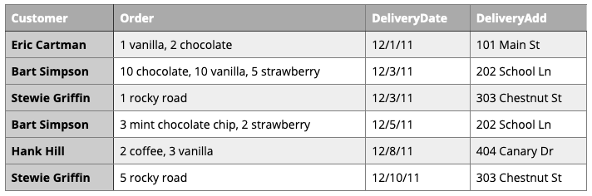
Spatial Databases: An Example*
First attempt:
Is this table schema acceptable? Why or why not?
Justin Gould | gould29 | REEU 2021
* Courtesy of GEOG 868 – Penn State
Notes:
The problem with this design becomes clear when you imagine trying to write a query that calculates the number of gallons of vanilla that have been ordered. The quantities are mixed with the names of the flavors and any one flavor could be listed anywhere within the order field (i.e., it won't be consistently listed first or second).

Slide 29
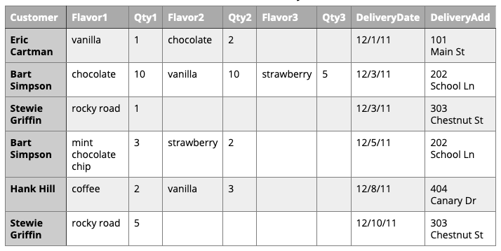
Spatial Databases: An Example*
Ok, let’s address the order flavor issue…
Is this table schema acceptable? Why or why not?
Justin Gould | gould29 | REEU 2021
* Courtesy of GEOG 868 – Penn State
Notes:
This is an improvement because it enables querying on flavors and summing quantities. However to calculate the gallons of vanilla ordered you would need to sum the values from three fields. Also the design would break down if a customer ordered more than three flavors.

Slide 30
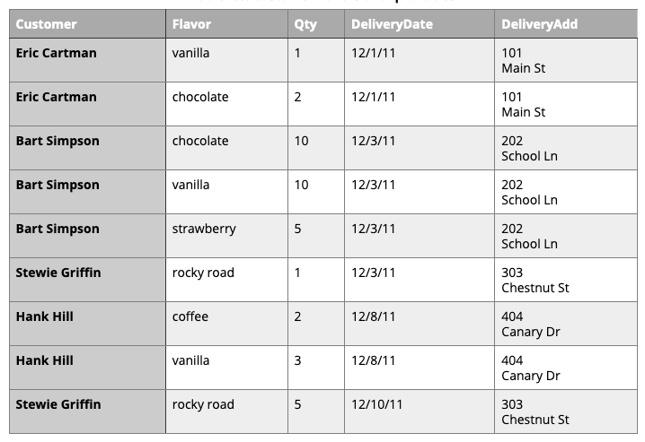
Spatial Databases: An Example*
Third time’s the charm?
Is this table schema acceptable? Why or why not?
Justin Gould | gould29 | REEU 2021
* Courtesy of GEOG 868 – Penn State
Notes:
This design makes calculating the gallons of vanilla ordered much easier. Unfortunately it also produces a lot of redundant data and spreads a complete order from a single customer across multiple rows.

Slide 31
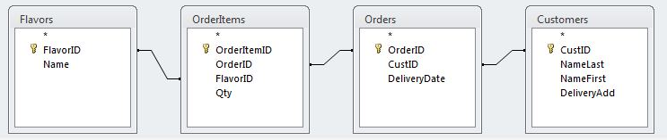
Spatial Databases: An Example*
Let’s split data into four entities: Customers, Flavors, Orders, and Order Items
Justin Gould | gould29 | REEU 2021
* Courtesy of GEOG 868 – Penn State

Slide 32
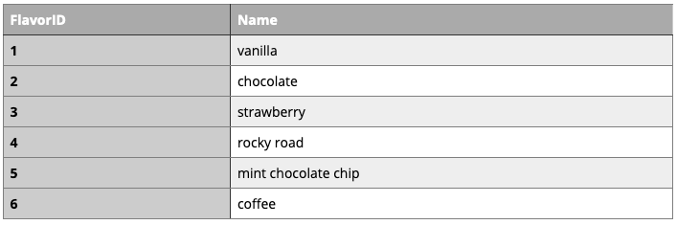
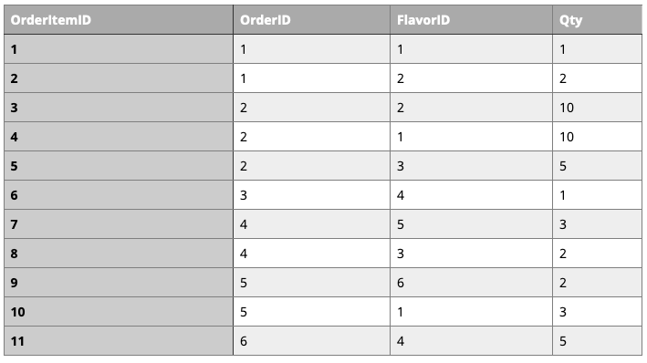
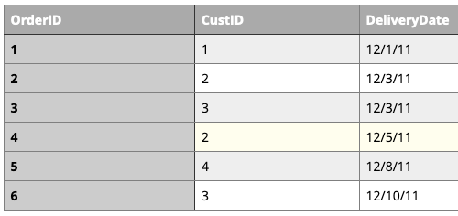
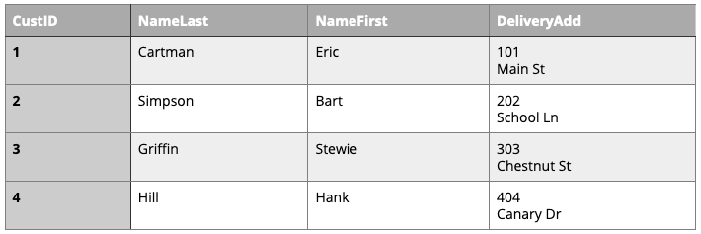
Spatial Databases: An Example*
Justin Gould | gould29 | REEU 2021
* Courtesy of GEOG 868 – Penn State

Slide 33
Spatial Databases: An Example*
An order would leverage all four tables:
Ice Cream Flavors:
Flavor ID
Name of flavor
Order Details:
Order Item ID
Order ID
Flavor ID
Qty of ice cream flavor
Order Info:
Order ID
Customer info
Delivery date
Customer Info:
Customer ID
Name
Address
Justin Gould | gould29 | REEU 2021
* Courtesy of GEOG 868 – Penn State

Slide 34
Today’s Activity
The United States Postal Service (USPS) is a massive, complex logistics operation. In an effort to improve customer service, the organization would like to provide customers with real-time information on processing and current location of each shipped item. To do this, the USPS must leverage an organization-wide data entry and retrieval system (database). The USPS is asking for your help to create the database that will store these critical data for the feature.
Database Requirements:
Shipped items can be characterized by item number unique, weight, dimensions, insurance amount, destination, and final delivery date.
Shipped items are received into the USPS system at a single retail center. Retail centers are characterized by their type, uniqueID, and address.
Shipped items make their way to their destination via one or more standard USPS transportation events (e.g., flights, truck deliveries, etc.). These transportation events are characterized by a unique scheduleNumber, a type (e.g., flight, truck, etc.), and a deliveryRoute.
Please create an entity relationship diagram that captures this information about the USPS item-tracking system.
Justin Gould | gould29 | REEU 2021
* Courtesy of GEOG 868 – Penn State

Slide 35
Map Design Principles

Slide 36
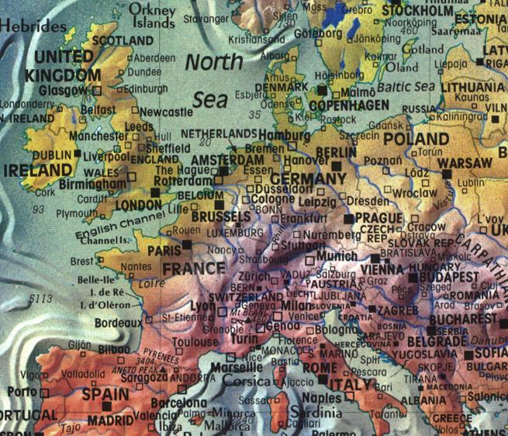
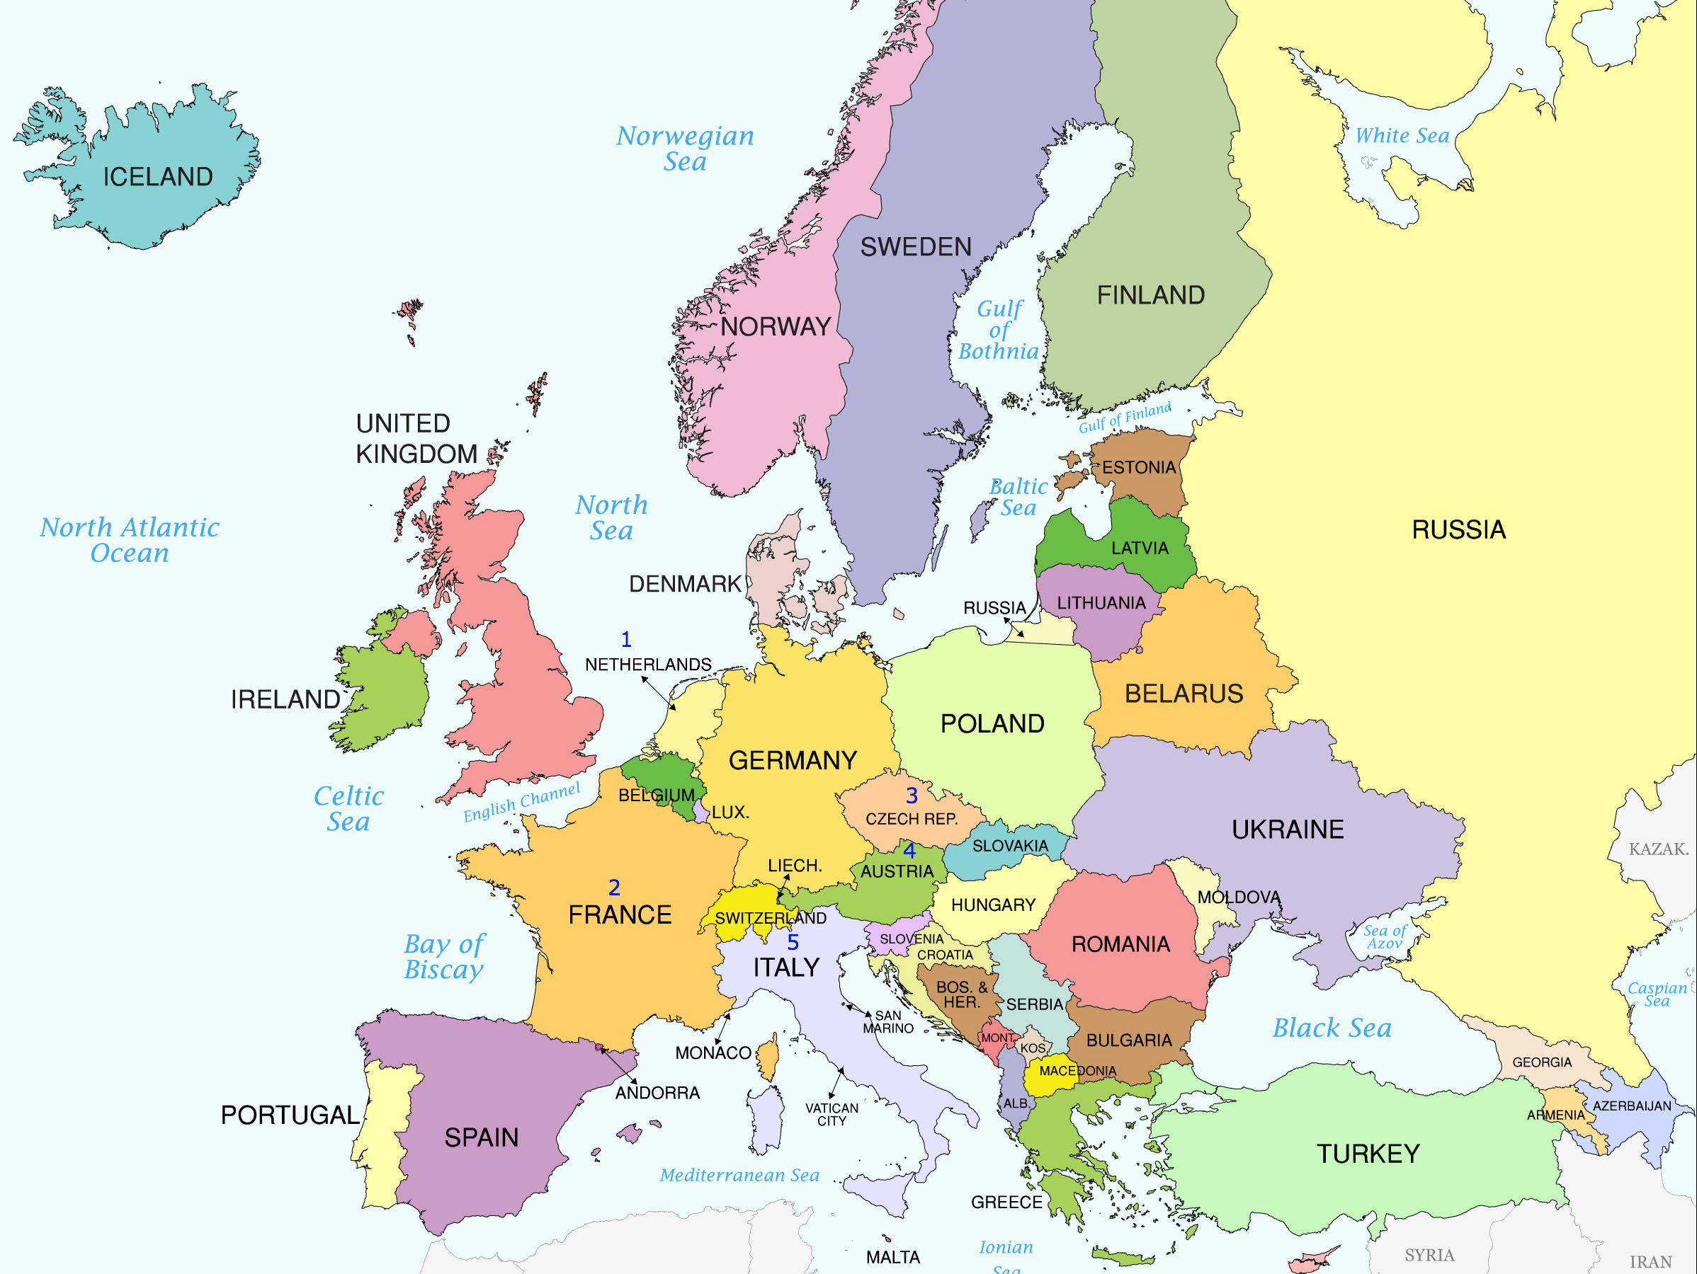
Map Design Principles
What makes a map “good” or “readable”?
Justin Gould | gould29 | REEU 2021

Slide 37
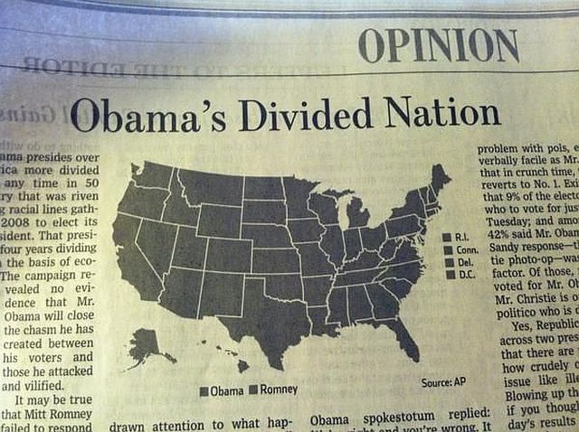
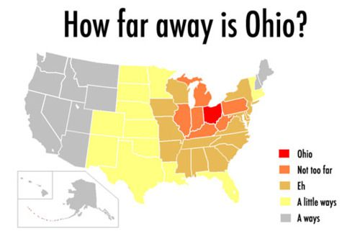
Map Design Principles
What makes a map “good” or “readable”?
Justin Gould | gould29 | REEU 2021
Notes:
https://www.vox.com/2015/2/18/8056325/bad-maps

Slide 38
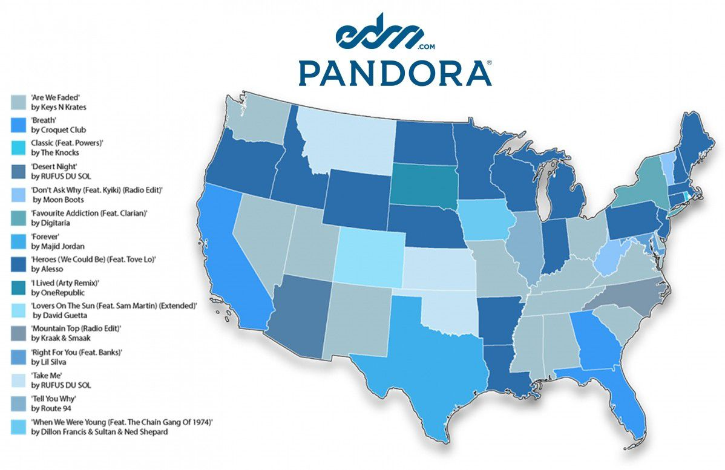
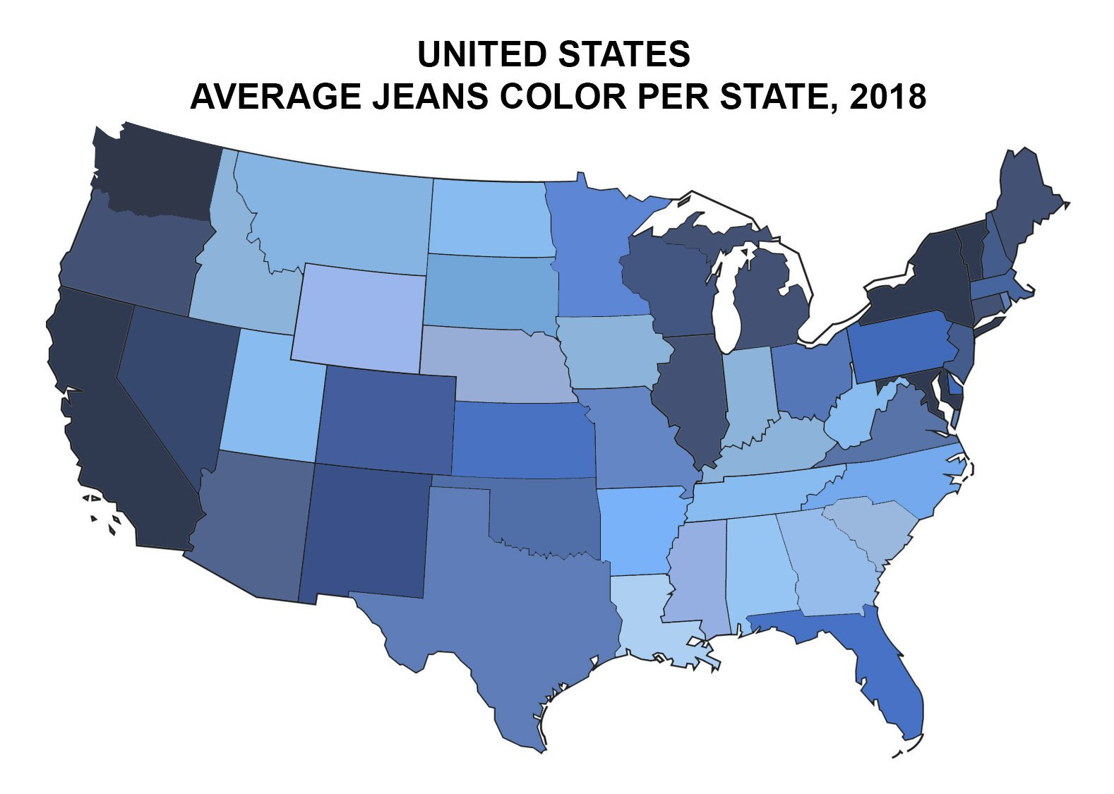
Map Design Principles
Ok, last two…
Justin Gould | gould29 | REEU 2021
Notes:
https://www.vox.com/2015/2/18/8056325/bad-maps

Slide 39
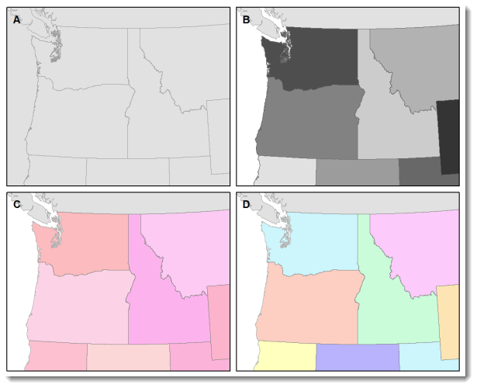
Map Design Principles: Visual Contrast
Visual contrast which relates to how map features and page elements contrast with each other and their background.
A well-designed map with a high degree of visual contrast can result in a crisp, clean, sharp-looking map.
The higher the contrast between features, the more something will stand out, usually the feature that is darker or brighter.
A map that has low visual contrast can be used to promote a more subtle impression.
Justin Gould | gould29 | REEU 2021
Notes:
Figure 1. When there is no variation in visual contrast (A), the map reader has a hard time distinguishing features from the background. For quantitative distributions (B), there must be enough contrast between tones for the reader to distinguish unique classes. For qualitative distributions (C),using variations of a single color hue (e.g., red) does not provide as much contrast as using a variety of hues (e.g., red, green, blue, etc.)

Slide 40
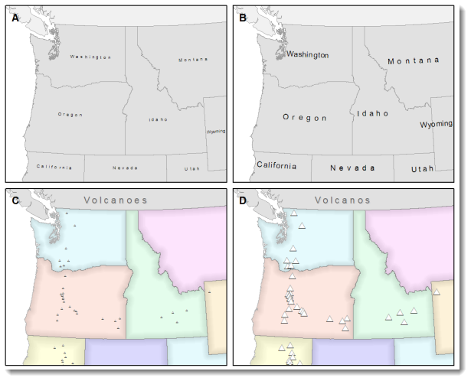
Map Design Principles: Legibility
Legibility depends on good decision-making for selecting symbols that are familiar and choosing appropriate sizes so that the results are effortlessly seen and easily understood.
Geometric symbols are easier to read at smaller sizes; more complex symbols require larger amounts of space to be legible.
Visual contrast and legibility are the basis for seeing. In addition to being able to distinguish features from one another and the background, the features need to be large enough to be seen and to be understood for your mind to decipher what you eyes are detecting.
Justin Gould | gould29 | REEU 2021
Notes:
Figure 2. Text and symbols (A and C) that are too small cannot be seen. Once able to be seen (B and D), they must also be understood.

Slide 41
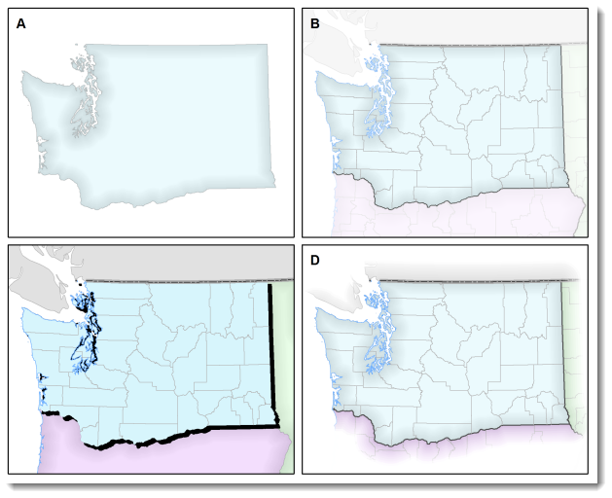
Map Design Principles: Figure-Ground
Figure-ground organization is the spontaneous separation of the figure in the foreground.
This helps in the over-arching goal to make your map as legible, valuable, and accessible as possible.
Take, for example, the image on the right. The figure-ground approach here is focused on county-level separation of the map.
Justin Gould | gould29 | REEU 2021
Notes:
Figure 3. Using closed forms (A), a white wash (B) , a drop shadow (C), or feathering (D) will promote figure-ground organization on your map.

Slide 42
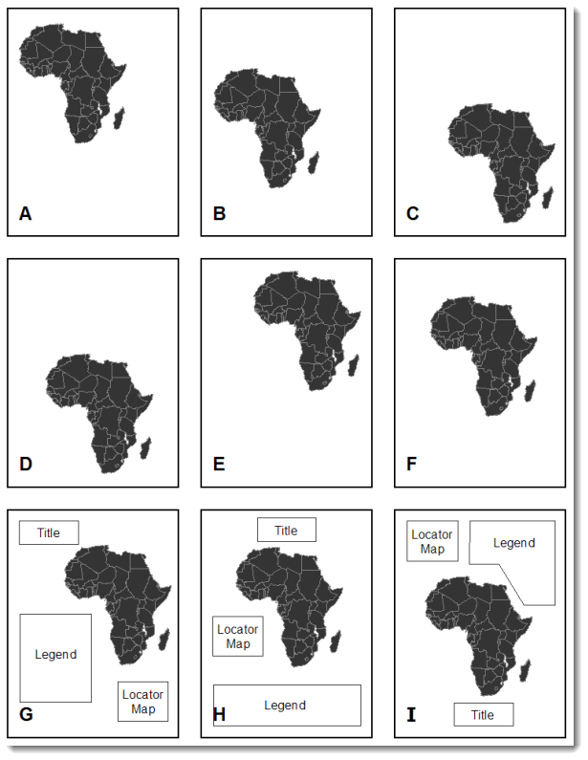
Map Design Principles: Hierarchical Organization
The internal graphic structuring of the map (and the page layout more generally) is fundamental to helping people read your map.
Some page elements (e.g., the map) will seem more important than others (e.g., the title or legend). This visual layering of information within the map and on the page helps readers focus on what is important and enables them to identify patterns.
Balance results from two primary factors, visual weight and visual direction.
Justin Gould | gould29 | REEU 2021
Notes:
Figure 4. Which of the top six maps seems most balanced? It should appear that (F) has visual equilibrium, usually achieved by placing the central figure slightly above center on the page. However, the addition of page elements, such as the title and legend, will modify the visual impression, so all content on the page should be evaluated together to judge balance.

Slide 43
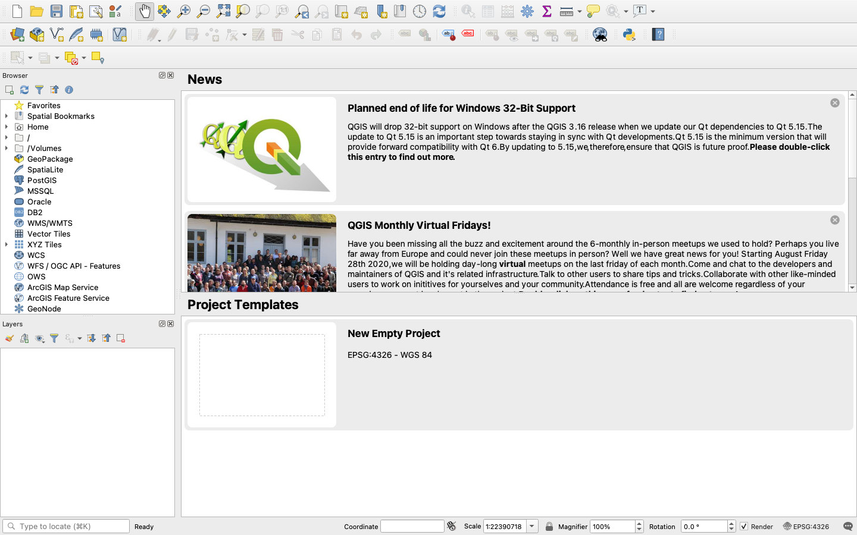
Visualizing Maps via QGIS
Home page, after opening the app
Justin Gould | gould29 | REEU 2021

Slide 44

Visualizing Maps via QGIS
Create a new project
Upon clicking, the screen will be white.
Justin Gould | gould29 | REEU 2021

Slide 45
Visualizing Maps via QGIS
We can create our layer using two methods:
Shapefile (as we did in our notebook)
merged.csv (the result of preprocessing in the notebook)
I will show you both…
Justin Gould | gould29 | REEU 2021

Slide 46

Visualizing Maps via QGIS
Now, insert a new vector layer, given that we have the shapefile of the London boroughs.
Justin Gould | gould29 | REEU 2021

Slide 47

Visualizing Maps via QGIS
Your Data Source Manager prompt should look like this.
Justin Gould | gould29 | REEU 2021

Slide 48

Visualizing Maps via QGIS
Keep the defaults for handling the shapefile layer and hit OK.
Justin Gould | gould29 | REEU 2021

Slide 49

Visualizing Maps via QGIS
To create the layer from the merged.csv file, your Data Source Manager should look like this.
Note the Geometry Definition parameters…
Justin Gould | gould29 | REEU 2021

Slide 50

Visualizing Maps via QGIS
We have a map!
But, like last time, this has no value. Let’s go ahead and add values and create a choropleth map, as we did via matplotlib and geopandas.
Justin Gould | gould29 | REEU 2021

Slide 51

Visualizing Maps via QGIS
Duplicate the existing layer and rename it as:
population_density
You can do these by right-clicking the layer
Justin Gould | gould29 | REEU 2021

Slide 52

Visualizing Maps via QGIS
Right-click the new layer again and open properties tab
Navigate to Symbology
Justin Gould | gould29 | REEU 2021

Slide 53

Visualizing Maps via QGIS
Make the following changes:
Single Symbol to Graduated
Value = pop_density_per_hectare
Precision 2
Mode = Natural Breaks (Jenks)
Classes = 5
Justin Gould | gould29 | REEU 2021

Slide 54


Visualizing Maps via QGIS
Uncheck the original layer to hide it, and show the new population density layer
Justin Gould | gould29 | REEU 2021

Slide 55


Visualizing Maps via QGIS
Great, now let’s add some labels to enable our viewers to understand the map and its underlying data…
To do this, we will create a new print layout
Give it a fun name, like:
Justin Gould | gould29 | REEU 2021

Slide 56

Visualizing Maps via QGIS
Add our map
Justin Gould | gould29 | REEU 2021

Slide 57

Visualizing Maps via QGIS
This will prompt a dragging tool; center the map in the middle of the page, as depicted right
Justin Gould | gould29 | REEU 2021

Slide 58


Visualizing Maps via QGIS
Let’s add a title by adding a label
Once you’ve added the label, rename the item as “title” and click the item to alter its appearance
Justin Gould | gould29 | REEU 2021

Slide 59


Visualizing Maps via QGIS
To adjust font and size, please click “Font” under “Appearance” tab
Pick anything you like!
Justin Gould | gould29 | REEU 2021

Slide 60

Visualizing Maps via QGIS
Do the same thing to add a source label…
Justin Gould | gould29 | REEU 2021

Slide 61


Visualizing Maps via QGIS
Now, we need to add a legend
Drag it where you’d like. I suggest the right-hand side of the map.
Uh oh – the legend is showing the original, attribute-less layer. Let’s eliminate it.
Justin Gould | gould29 | REEU 2021

Slide 62


Visualizing Maps via QGIS
To eliminate the unused, original layer:
Under “Item Properties” check the “Only show items inside linked map” box
Justin Gould | gould29 | REEU 2021

Slide 63

Visualizing Maps via QGIS
From here, you can save the project and export in a variety of formats
Justin Gould | gould29 | REEU 2021

Slide 64

Visualizing Maps via QGIS
Final map!
Justin Gould | gould29 | REEU 2021

Slide 65
Today’s Activity
Visualizing Maps via Python
Today’s data and Jupyter notebook are available on our course drive.
Visualizing Maps via QGIS
Please see the Covid Assignment folder for the activity.
Justin Gould | gould29 | REEU 2021

Slide 66
PostGIS

Slide 67


What is PostGIS?
Directly from the creators:
PostGIS is a spatial database extender for PostgreSQL object-relational database. It adds support for geographic objects allowing location queries to be run in SQL.
What would this query return?
Justin Gould | gould29 | REEU 2021
Notes:
The name of the superhero from Gotham—Batman

Slide 68
Day 1: Primary Lecture Content
Please use our lecture notebook for today to ensure you have access to our postgres DB on scholar: postgis_geddes.ipynb
This is available on our course drive
As always, I suggest you refer to our textbook for additional reference material, as well as this cheat sheet: http://www.postgis.us/study_guides
Cheat sheets are available on our course drive, under ./resources
Justin Gould | gould29 | REEU 2021

Slide 69
Days 1 and 2: Primary Lecture Content
One you ensure access to our DB on scholar, please use our lecture notebook for today: advanced_postgis.ipynb
This is available on our course drive
The notebook will take us 2 days to get through
As always, I suggest you refer to our textbook for additional reference material, as well as this cheat sheet: http://www.postgis.us/study_guides
Cheat sheets are available on our course drive, under ./resources
Justin Gould | gould29 | REEU 2021

Slide 70

Today’s Activity
Please see the assignment on our course drive, under PostGIS
reeu2021_postgis.pdf
Justin Gould | gould29 | REEU 2021

